Slide 1
Linear Algebra for Data science

Slide 2
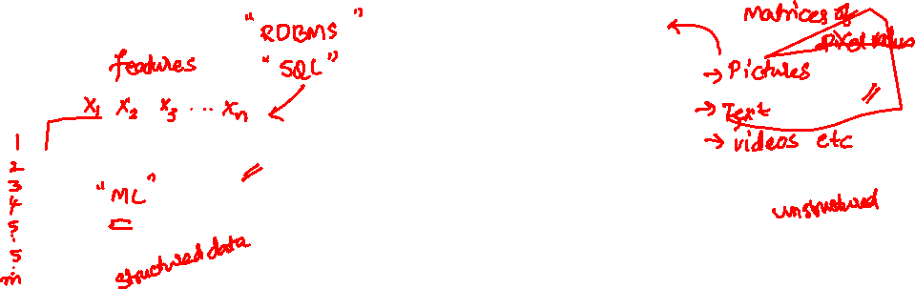
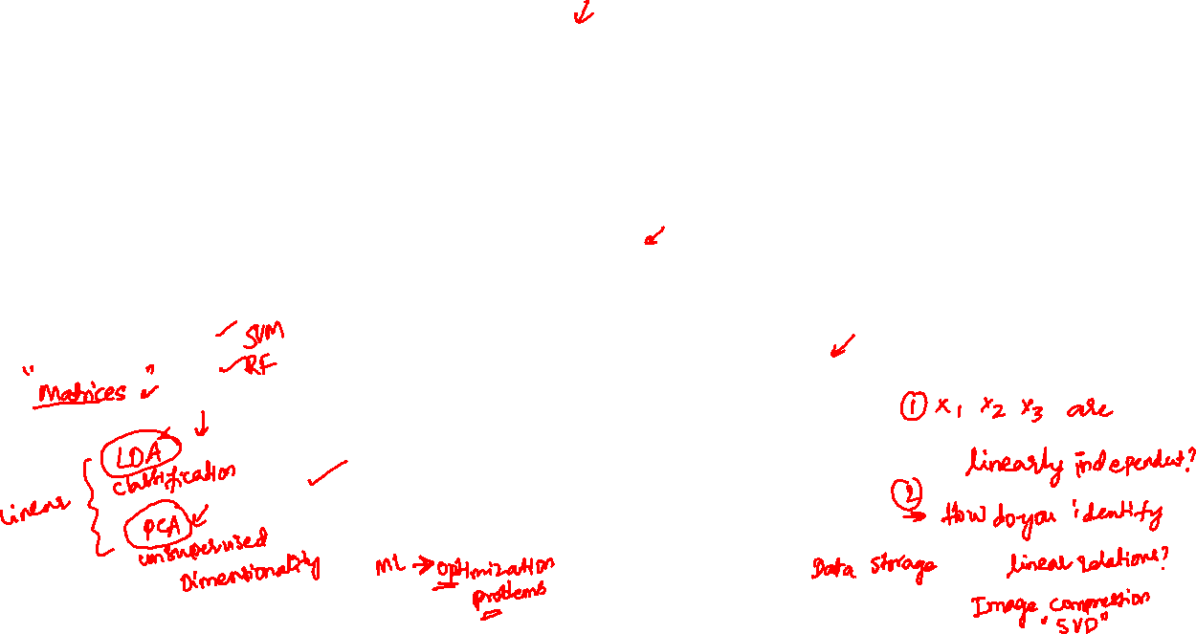
Motivation
Linear Algebra
Data Representation
Identifying linear relations
Fundamental block in machine learning algorithms

Slide 3
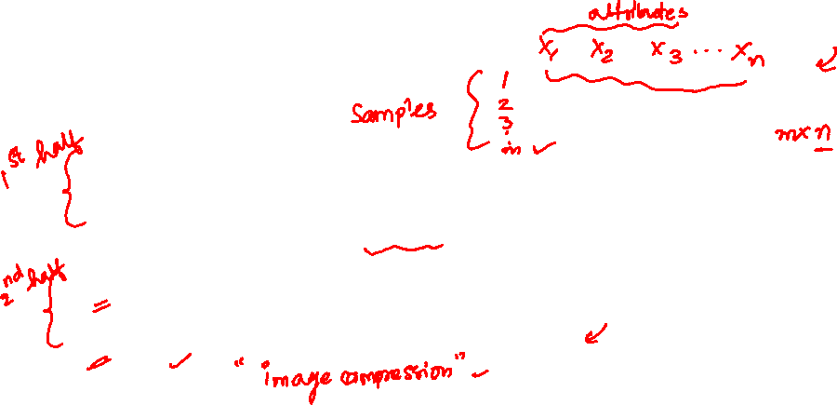
Outline
Understanding independence of variables
Understanding relationships between variables
Eigenvalues & eigenvectors
Singular value decomposition

Slide 4
Linear Algebra and Matrices

Slide 5
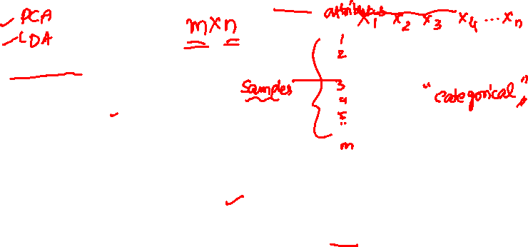
Matrices for data science: Data representation
Usually, matrices are used to store and represent the data on machines
Matrix is a very natural approach for organizing data
In general, data is organized in the following fashion
Rows represent samples
Columns represent the values of the variables (or attributes)
It is also possible to use rows for variables and columns for samples
However, we will stick to rows as samples and columns as variables in all of the material that will be presented

Slide 6
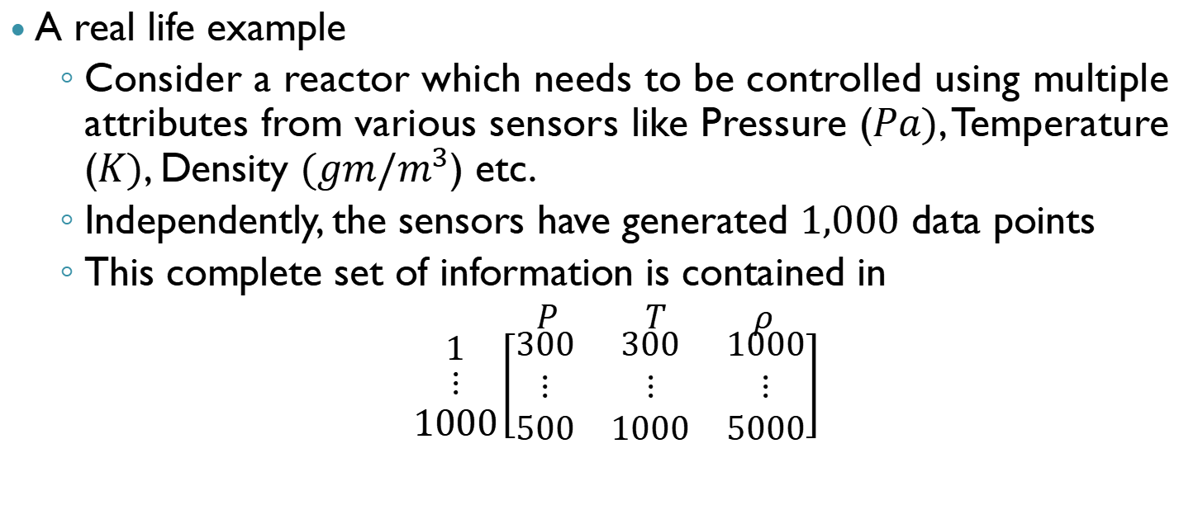
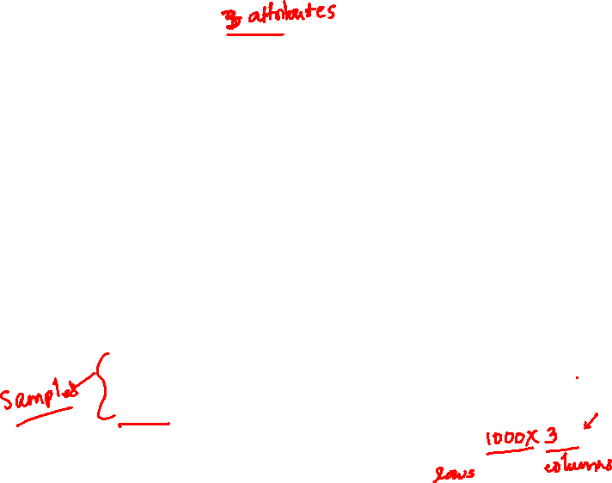
Representing data
A real life example
Consider a reactor which needs to be controlled using multiple attributes from various sensors like Pressure ($Pa)$, Temperature ($K)$, Density $(gm/m^{3}$) etc.
Independently, the sensors have generated $1,000$ data points
This complete set of information is contained in
$P T ρ$
$\begin{matrix}1 \\ \begin{aligned}⋮ \\ 1000\end{aligned}\end{matrix}\left[\begin{matrix}300 & 300 & 1000 \\ ⋮ & ⋮ & ⋮ \\ 500 & 1000 & 5000\end{matrix}\right]$

Slide 7
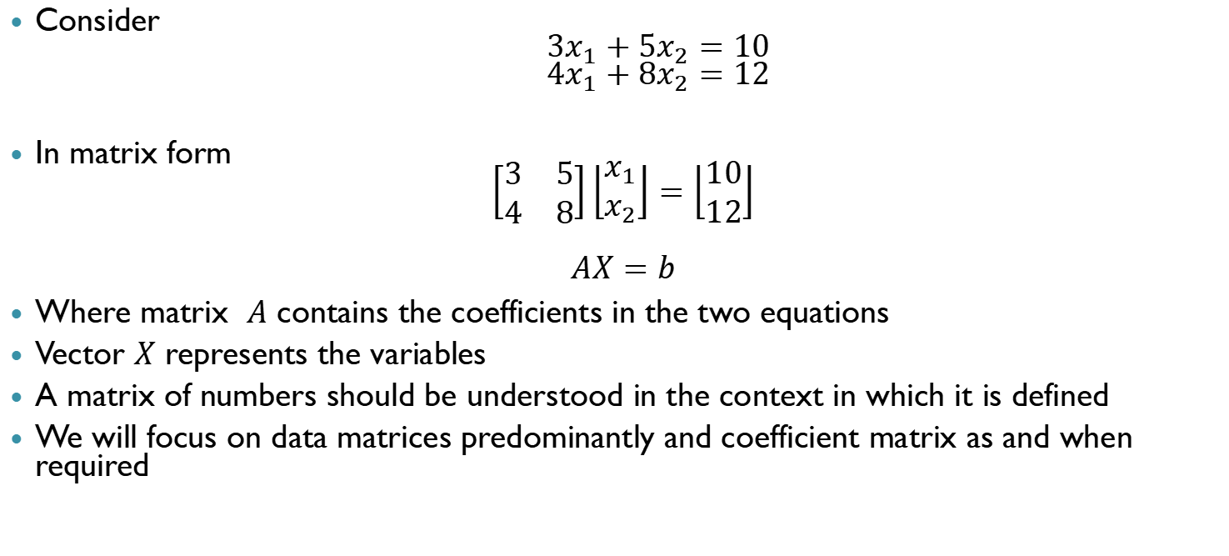
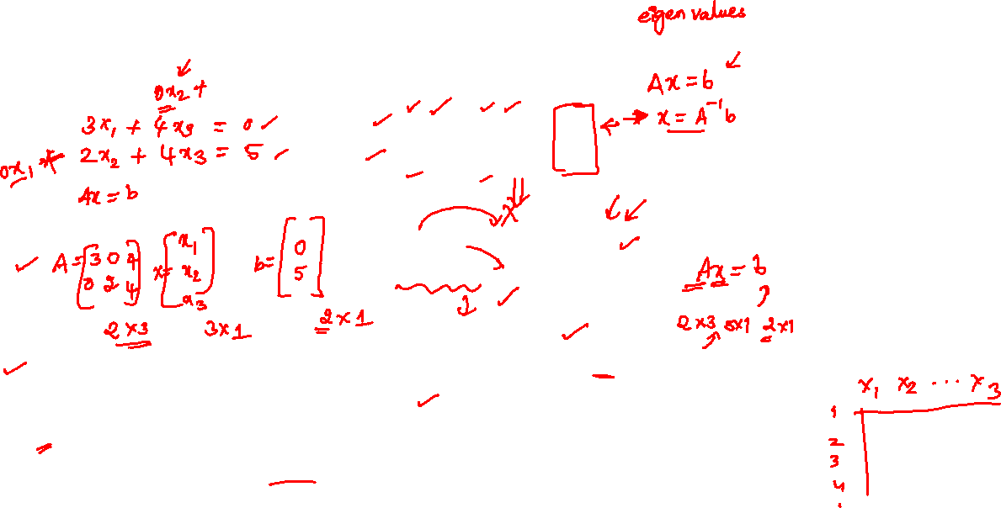
Representing linear equations
Consider
$${3x}_{1}+5x_{2}=10$$
$${4x}_{1}+8x_{2}=12$$
In matrix form
$$\left[\begin{matrix}3 & 5 \\ 4 & 8\end{matrix}\right]\left\lfloor \begin{matrix}x_{1} \\ x_{2}\end{matrix}\right\rfloor =\left\lfloor \begin{matrix}10 \\ 12\end{matrix}\right\rfloor$$
$$AX=b$$
Where matrix $A$ contains the coefficients in the two equations
Vector $X$ represents the variables
A matrix of numbers should be understood in the context in which it is defined
We will focus on data matrices predominantly and coefficient matrix as and when required

Slide 8
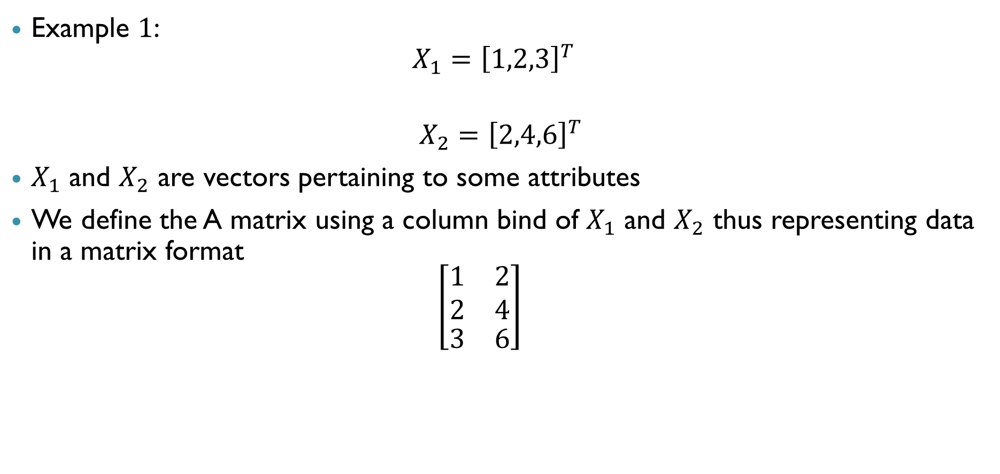
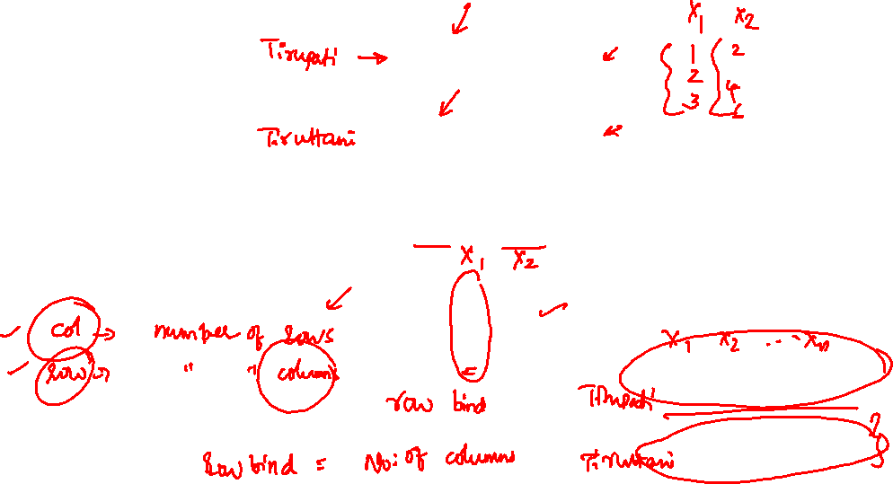
Combining data
Example $1$:
$$X_{1}={\left[1,2,3\right]}^{T}$$
$X_{2}={\left[2,4,6\right]}^{T}$
$X_{1}$ and $X_{2}$ are vectors pertaining to some attributes
We define the A matrix using a column bind of $X_{1}$ and $X_{2}$ thus representing data in a matrix format
$$\left[\begin{matrix}\begin{aligned}1 \\ 2\end{aligned} & \begin{aligned}2 \\ 4\end{aligned} \\ 3 & 6\end{matrix}\right]$$

Slide 9
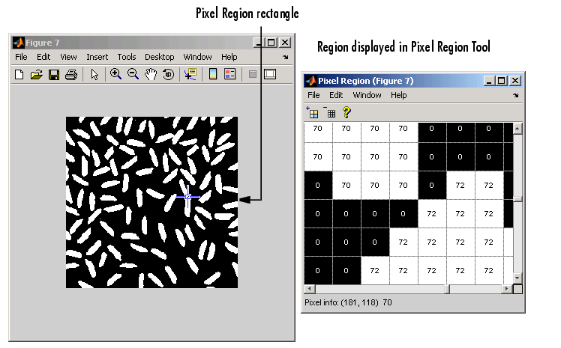
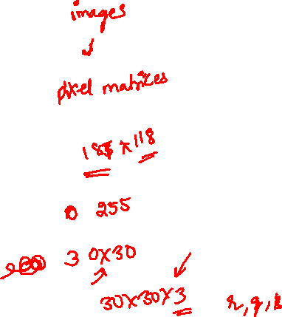
Image as a matrix
The simplicity in representation will become apparent when the image below is considered

Slide 10
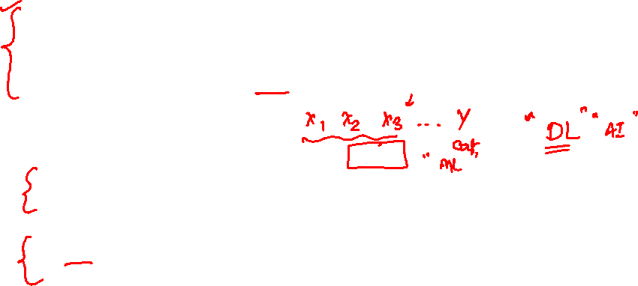
Machine learning using image matrices
Storing
The image is stored in the machine as a large matrix of pixel values across the image
Thus, storing the pixel value matrix is equivalent to storing the image for the machine
Identification
Several machine learning algorithms are deployed in order to “teach” the machine how to identify a particular image
Linear algebra and matrix operations are at the heart of these machine learning algorithms

Slide 11
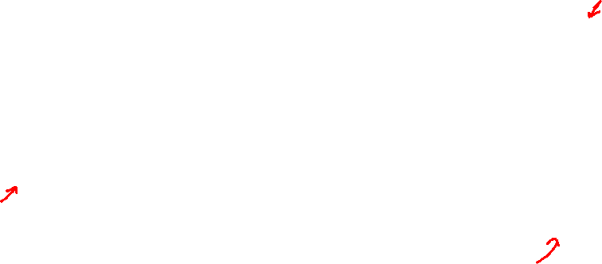
Data Matrix: Summary
Data Matrix
Rows
Columns
Samples (Data points)
Attributes (Variables)

Slide 12
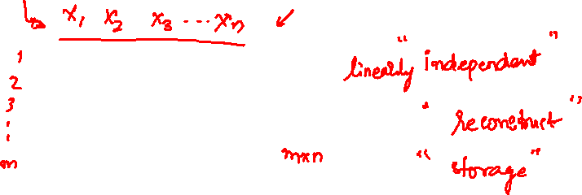
Understanding independence of variables

Slide 13
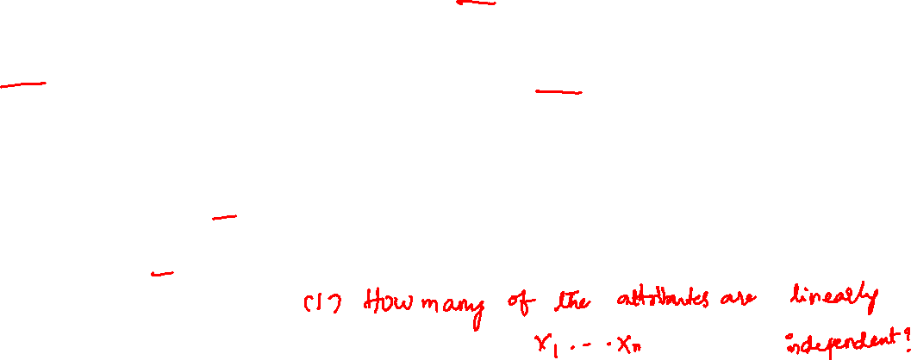
Further analysis
Now that we can represent the data into a matrix format, we ask the following questions
Are all the attributes in the data matrix relevant/ important?
Is there any method which can identify if some attributes are related to the other attributes?
If yes, how do we identify the linear relationship?
Can we use this to reduce the size of the data matrix?

Slide 14
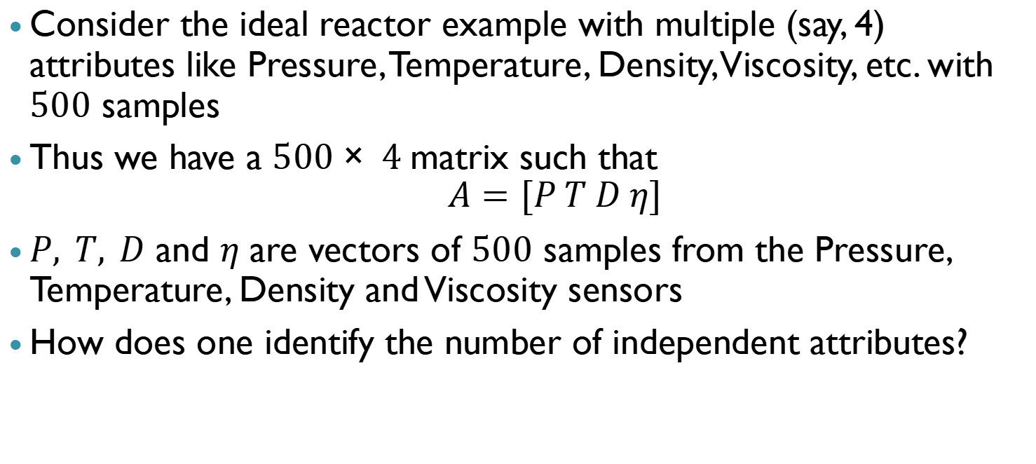
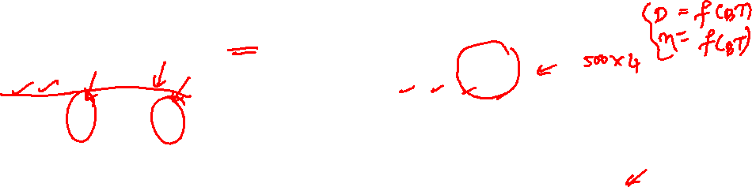
Identification of independent attributes: Example
Consider the ideal reactor example with multiple (say, 4) attributes like Pressure, Temperature, Density, Viscosity, etc. with $500$ samples
Thus we have a $500× 4$matrix such that
$$A=[P T D η]$$
$P, T, D$ and $η$ are vectors of $500$ samples from the Pressure, Temperature, Density and Viscosity sensors
How does one identify the number of independent attributes?

Slide 15
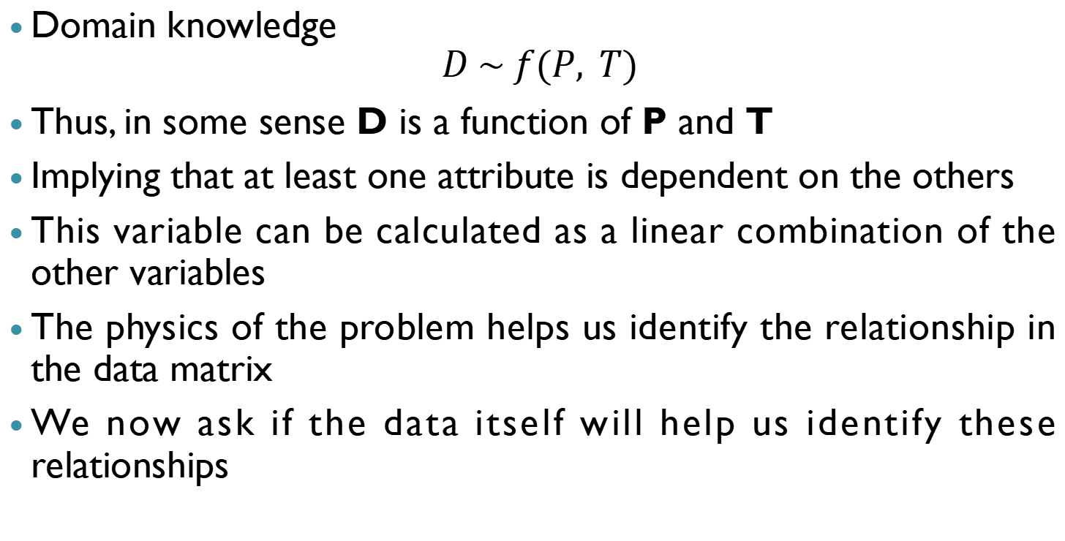
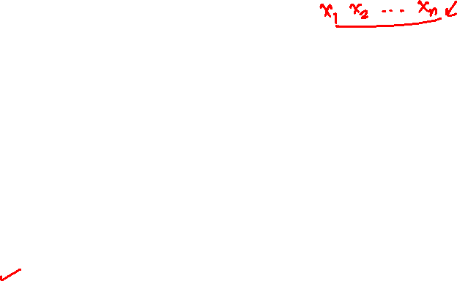
Identification of independent attributes: Example
Domain knowledge
$$D \sim f(P, T)$$
Thus, in some sense D is a function of P and T
Implying that at least one attribute is dependent on the others
This variable can be calculated as a linear combination of the other variables
The physics of the problem helps us identify the relationship in the data matrix
We now ask if the data itself will help us identify these relationships

Slide 16
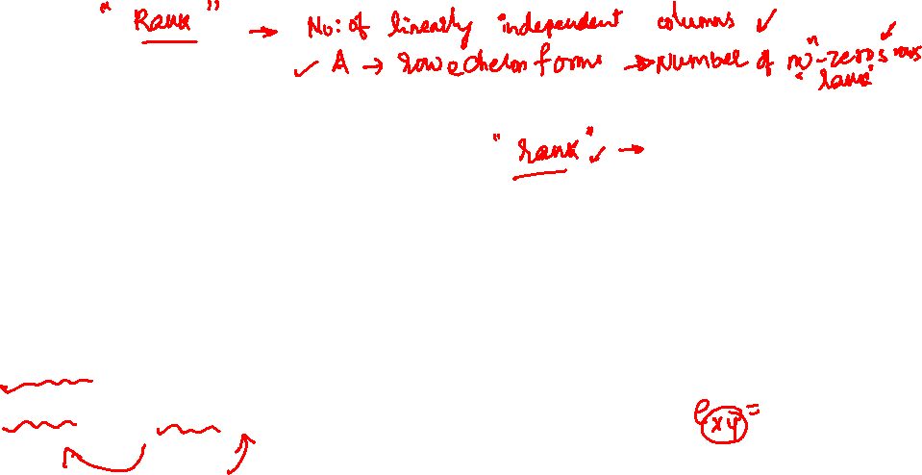
Number of independent attributes: Rank of a matrix
Let us assume that we have many more samples than attributes for now
Is there any approach which can be used to identify the number of linear relationships between the attributes purely using data?
This is addressed by the concept of the rank of the matrix
Rank of a matrix refers to the number of linearly independent rows or columns of the matrix

Slide 17
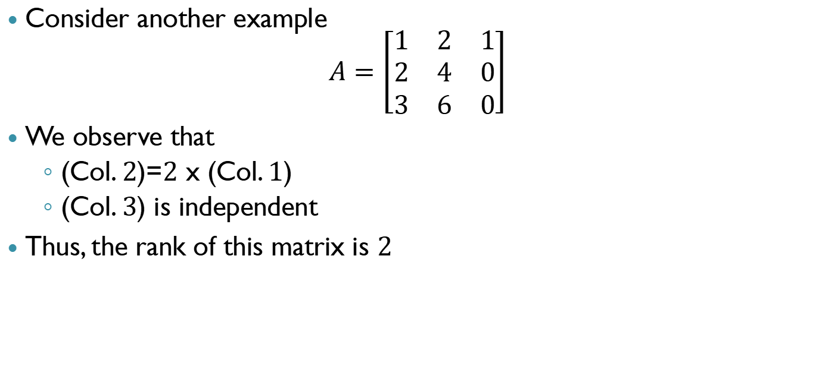

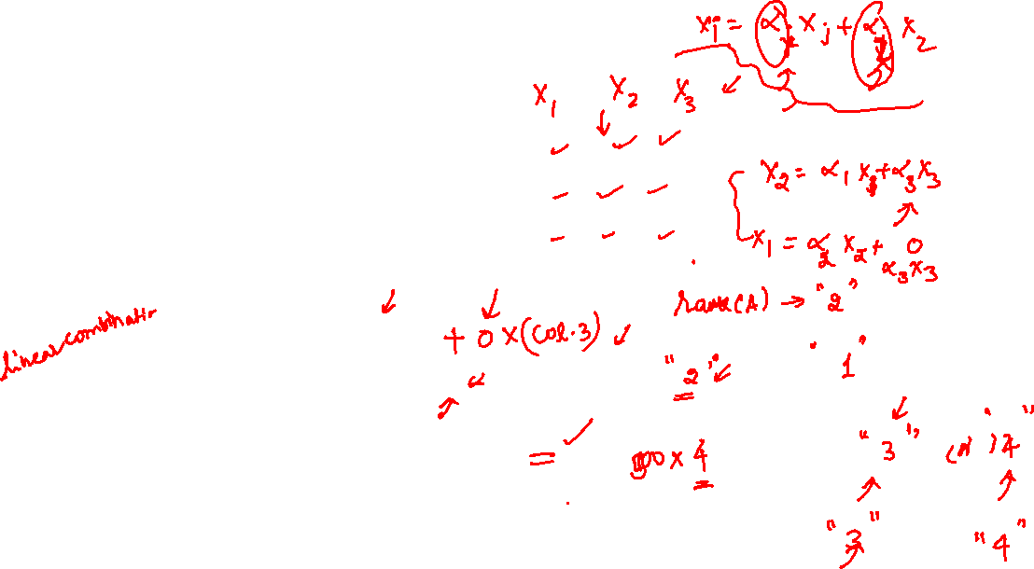
Rank of a matrix: Example $1$
Consider another example
$$A=\left[\begin{matrix}1 & 2 & 1 \\ 2 & 4 & 0 \\ 3 & 6 & 0\end{matrix}\right]$$
We observe that
(Col. $2$)=$2$ x (Col. $1$)
(Col. $3$) is independent
Thus, the rank of this matrix is $2$

Slide 18
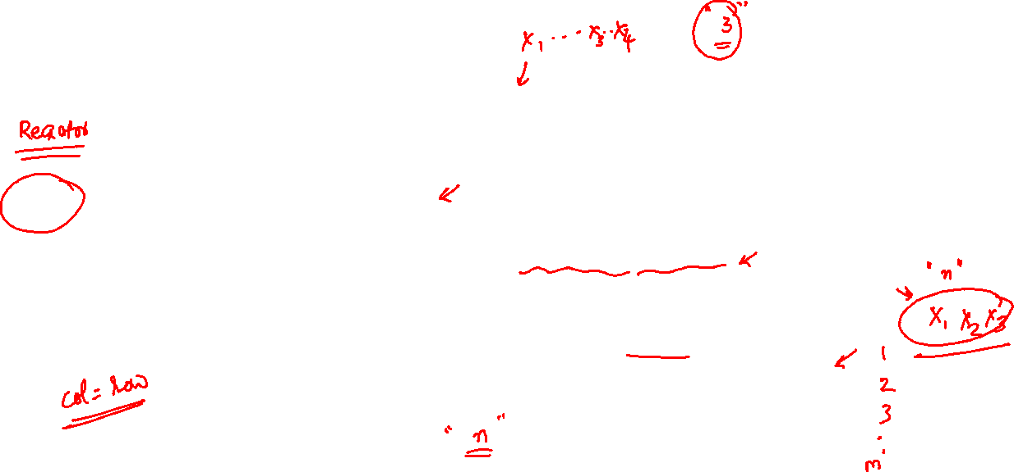
Rank: Advantages and summary
Rank
Work with reduced set of variables
Dependent attributes can be calculated if they are from the same data generation process
Independent of the size of the dataset if the data is from the same data generation process

Slide 19
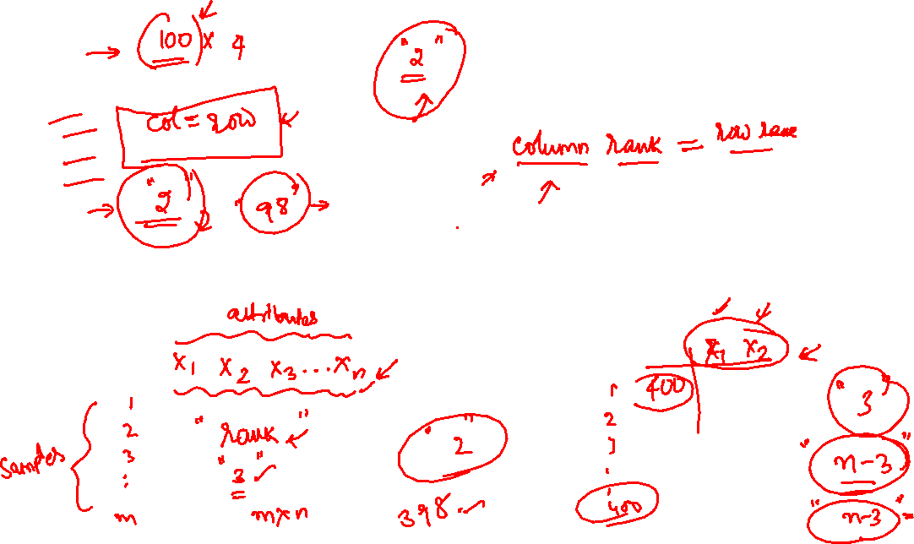
Understanding linear relationships between variables

Slide 20
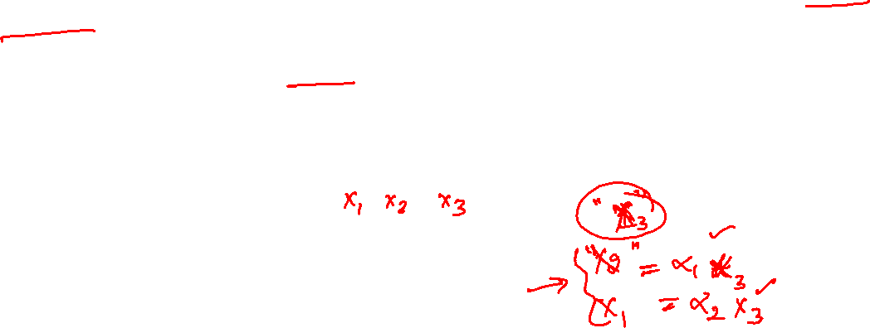
Linear relationships among attributes
Now that we have identified the number of linearly independent attributes:
How does one identify those linear relations among the attributes?
Such questions are addressed by the linear algebraic concept of nullity and null space

Slide 21
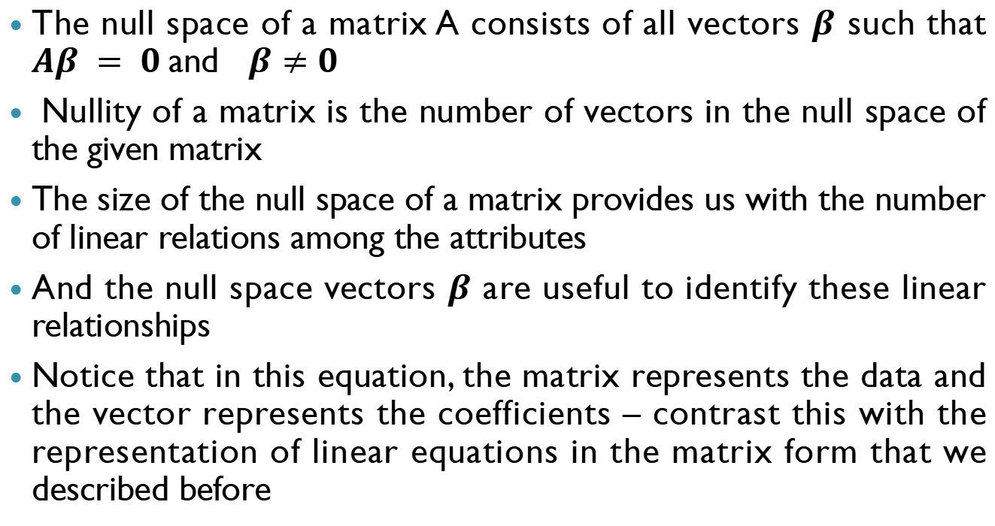
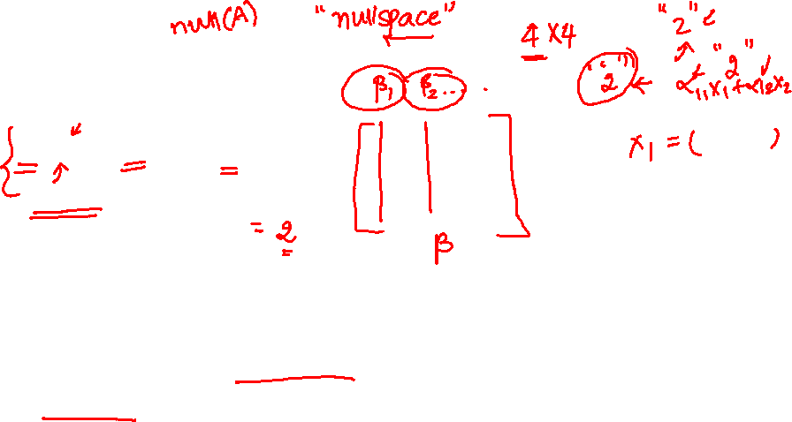
Null space for data science
The null space of a matrix A consists of all vectors $β$ such that $Aβ = 0$and $β≠0$
Nullity of a matrix is the number of vectors in the null space of the given matrix
The size of the null space of a matrix provides us with the number of linear relations among the attributes
And the null space vectors $β$ are useful to identify these linear relationships
Notice that in this equation, the matrix represents the data and the vector represents the coefficients – contrast this with the representation of linear equations in the matrix form that we described before

Slide 22
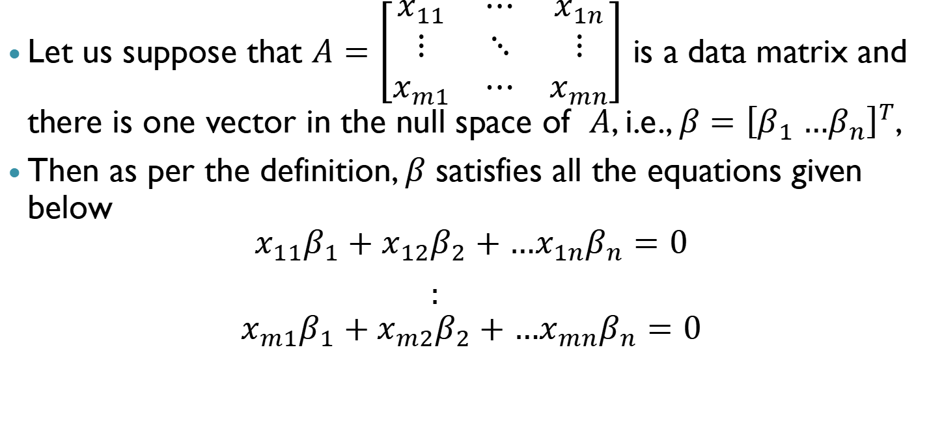
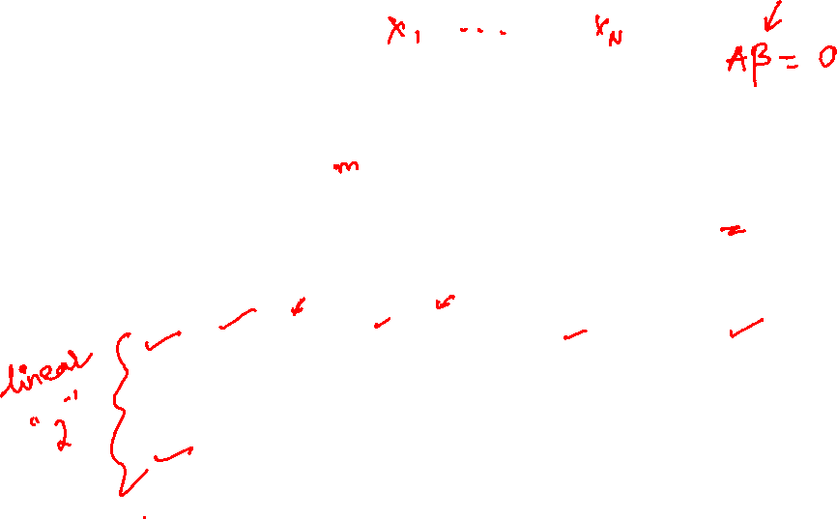
Null space: general description
Let us suppose that $A=\left[\begin{matrix}x_{11} & ⋯ & x_{1n} \\ ⋮ & ⋱ & ⋮ \\ x_{m1} & ⋯ & x_{mn}\end{matrix}\right]$ is a data matrix and there is one vector in the null space of $A$, i.e., $β={\left[β_{1} …β_{n}\right]}^{T}$,
Then as per the definition, $β$ satisfies all the equations given below
$$x_{11}β_{1}+x_{12}β_{2}+…x_{1n}β_{n}=0$$
$:$
$$x_{m1}β_{1}+x_{m2}β_{2}+…x_{mn}β_{n}=0$$

Slide 23
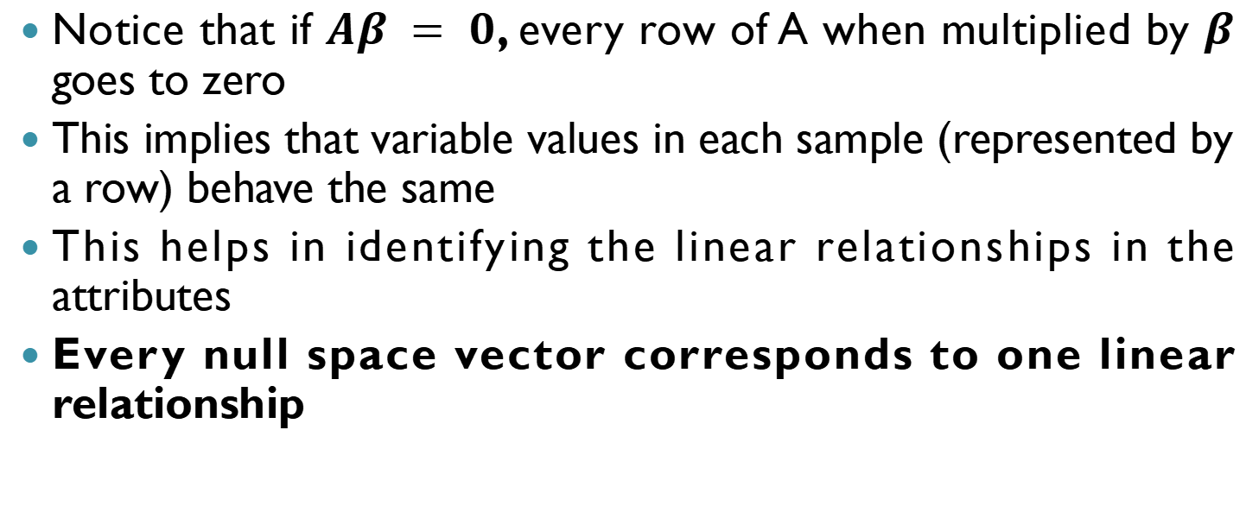

Null space: The idea
Notice that if $Aβ = 0$, every row of A when multiplied by $β$ goes to zero
This implies that variable values in each sample (represented by a row) behave the same
This helps in identifying the linear relationships in the attributes
Every null space vector corresponds to one linear relationship

Slide 24
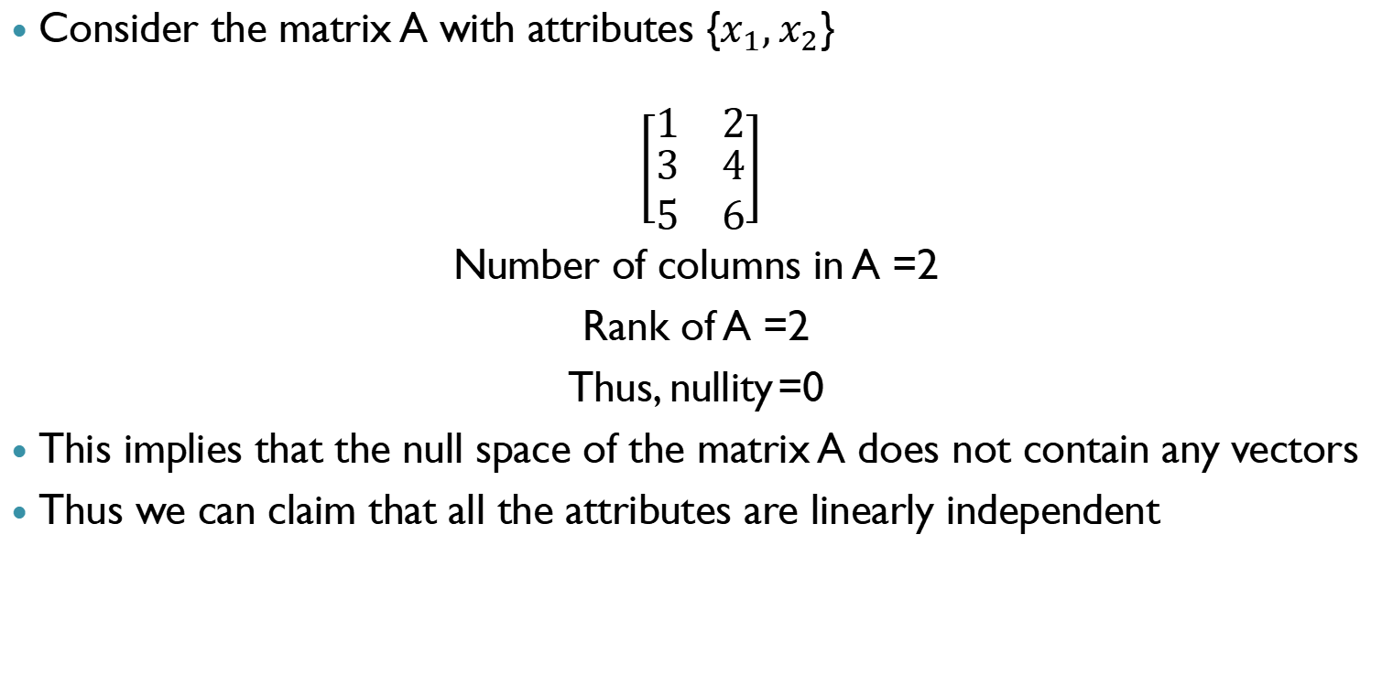
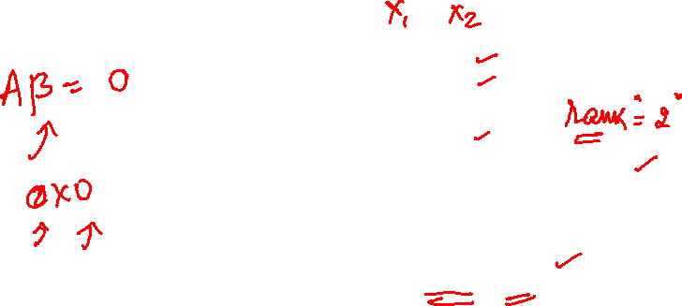
Null space: An Example
Consider the matrix A with attributes {$x_{1},x_{2}$}
$$\left[\begin{matrix}1 & 2 \\ \begin{aligned}3 \\ 5\end{aligned} & \begin{aligned}4 \\ 6\end{aligned}\end{matrix}\right]$$
Number of columns in A =2
Rank of A =2
Thus, nullity =0
This implies that the null space of the matrix A does not contain any vectors
Thus we can claim that all the attributes are linearly independent

Slide 25
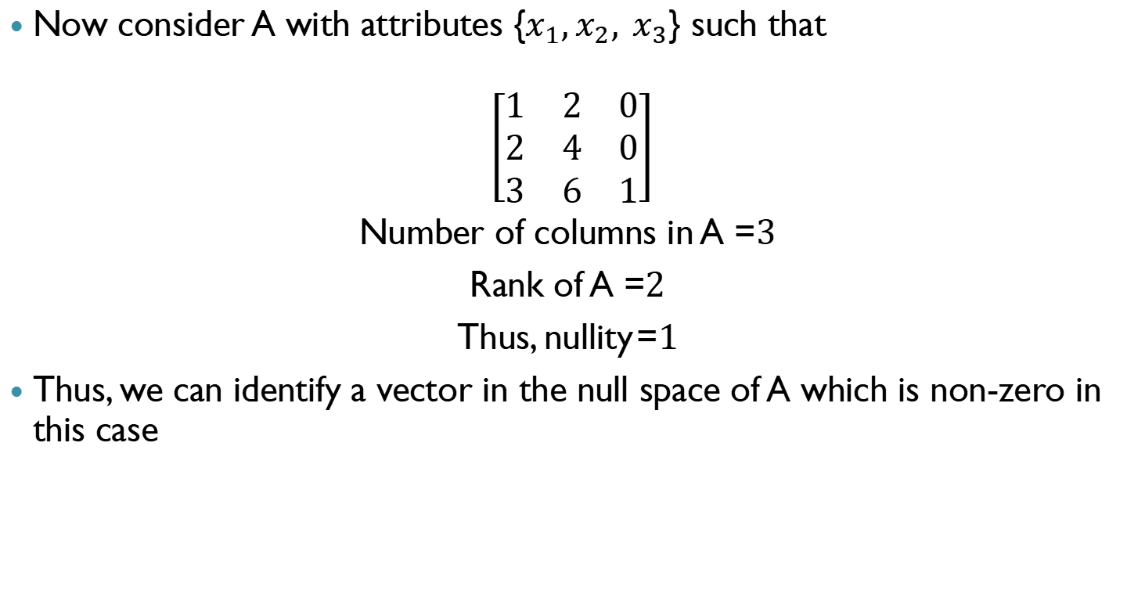
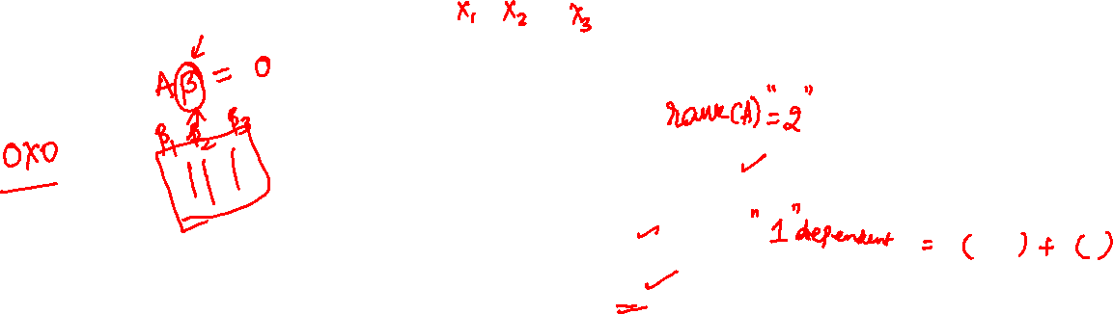
Null space: Another example
Now consider A with attributes {$x_{1},x_{2}, x_{3}$} such that
$$\left[\begin{matrix}1 & 2 & 0 \\ 2 & 4 & 0 \\ 3 & 6 & 1\end{matrix}\right]$$
Number of columns in A =$3$
Rank of A =$2$
Thus, nullity =$1$
Thus, we can identify a vector in the null space of A which is non-zero in this case

Slide 26
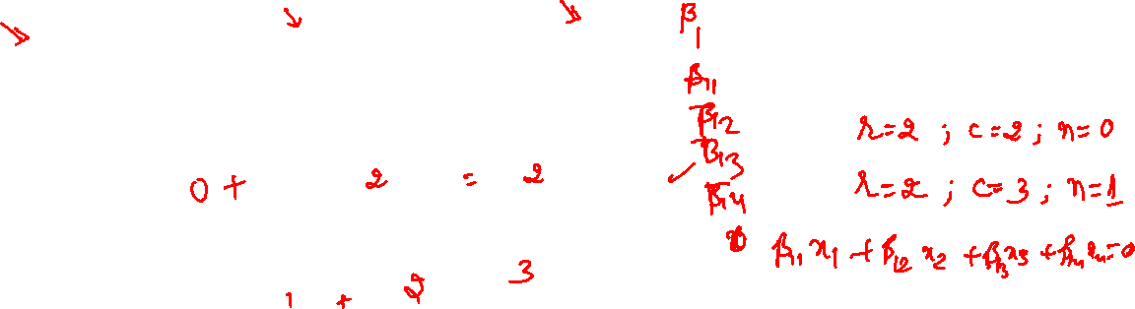
Rank nullity theorem
Consider the data matrix A with the null space and nullity as defined before
The rank- nullity theorem helps us to relate the nullity of the data matrix to the rank and the number of attributes in the data
According to the rank-nullity theorem
Nullity of A
Rank of A
Total number of attributes of A
Number of equations in Null space of data matrix
Number of independent variables
Total number of variables

Slide 27

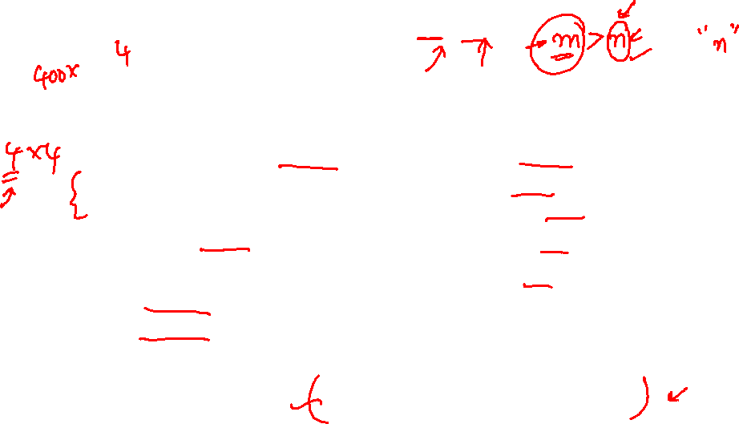
Full row and column rank: Concepts
Consider a data matrix $A (m×n)$
Full Row Rank
When all the rows of the matrix are linearly independent
Data sampling does not present a linear relationship – samples are independent
Full Column Rank
When all the columns of the matrix are linearly independent
Attributes are linearly independent
Row rank = Column rank

Slide 28
Linear Algebra – Vectors, Distance, Eigenvalues, Eigenvectors

Slide 29
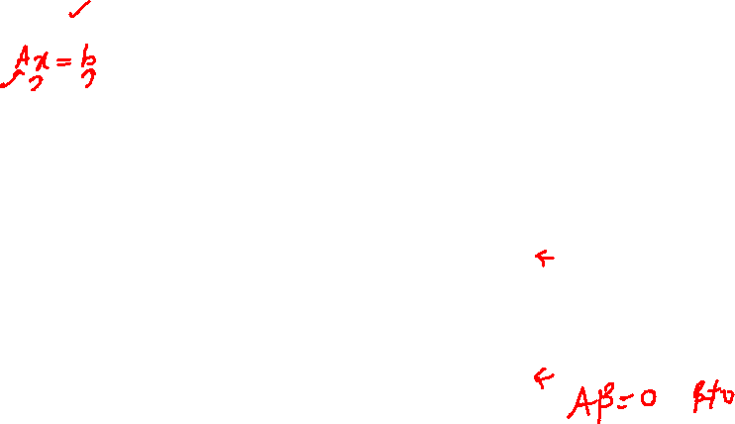
Summary
Matrix
Represent data in a matrix form with rows and columns representing samples and attributes respectively
Represent coefficients in several equations in a matrix form
Rank
Number of independent variables or samples
Nullity
Identifies the number of linear relationships (if any)
Null Space
Null space vectors provide the linear relationhips

Slide 30
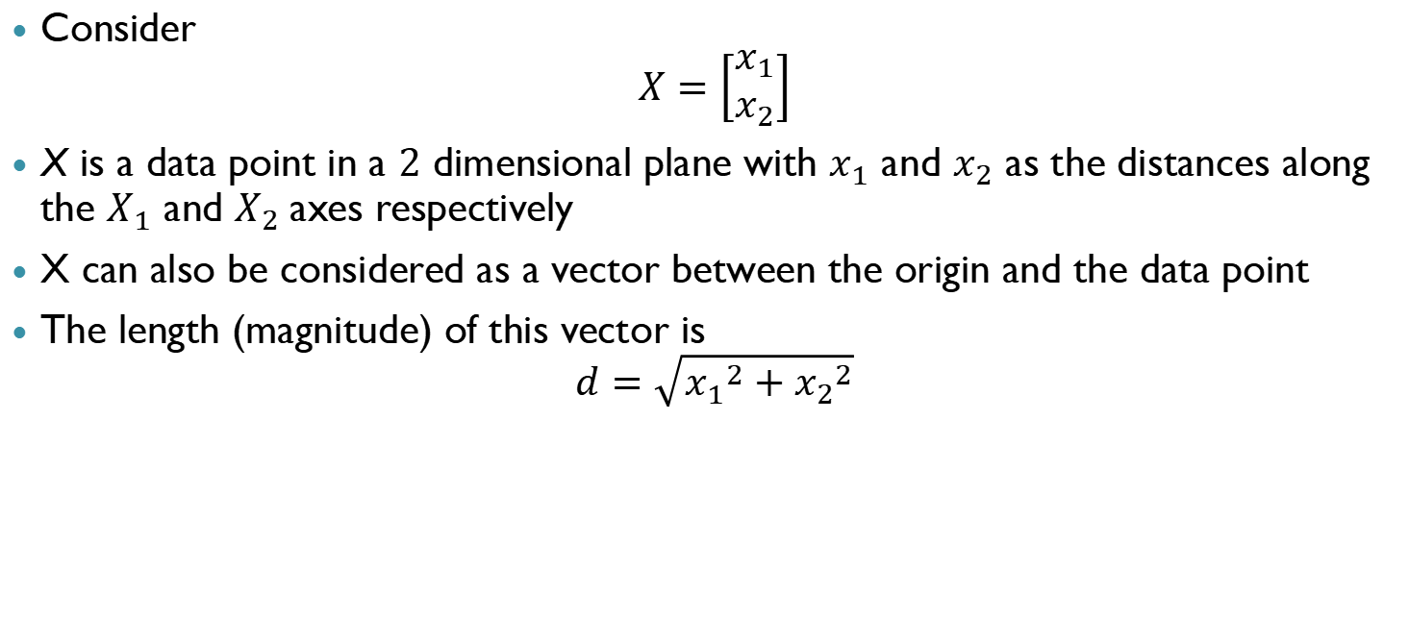

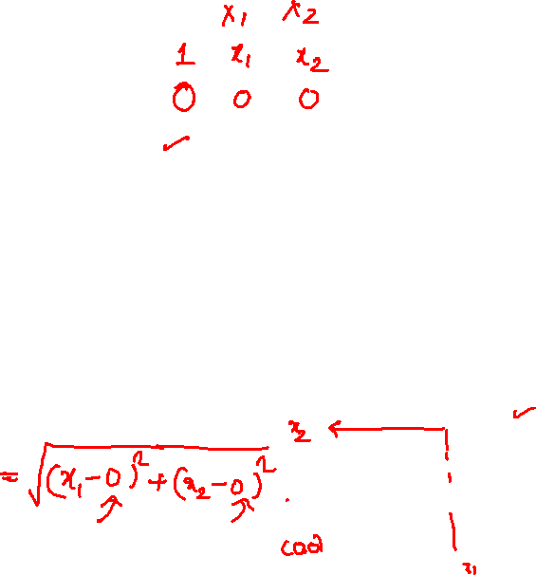
Vectors and lengths
Consider
$$X=\left[\begin{aligned}x_{1} \\ x_{2}\end{aligned}\right]$$
X is a data point in a $2$ dimensional plane with $x_{1}$ and $x_{2}$ as the distances along the $X_{1}$ and $X_{2}$axes respectively
X can also be considered as a vector between the origin and the data point
The length (magnitude) of this vector is
$$d=\sqrt{{x_{1}}^{2}+{x_{2}}^{2}}$$

Slide 31
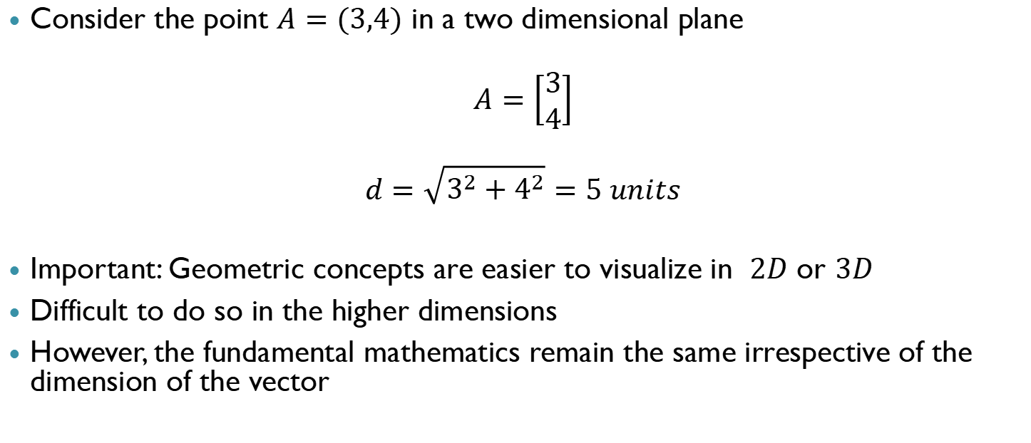
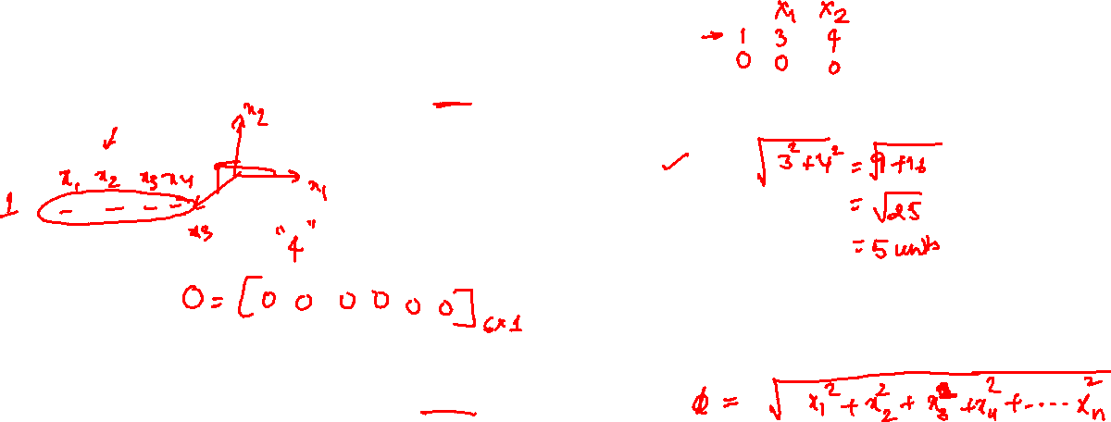
Vectors and lengths: Example
Consider the point $A=(3,4)$ in a two dimensional plane
$$A=\left[\begin{aligned}3 \\ 4\end{aligned}\right]$$
$$d=\sqrt{3^{2}+4^{2}}=5 units$$
Important: Geometric concepts are easier to visualize in $2D$ or $3D$
Difficult to do so in the higher dimensions
However, the fundamental mathematics remain the same irrespective of the dimension of the vector

Slide 32








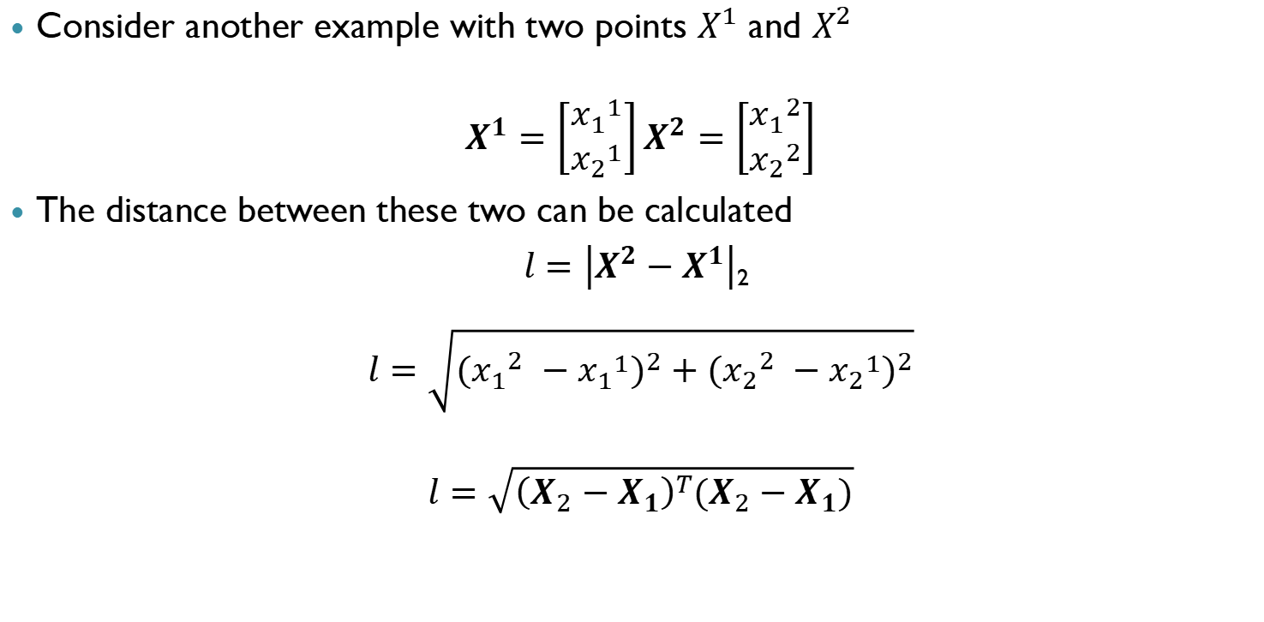




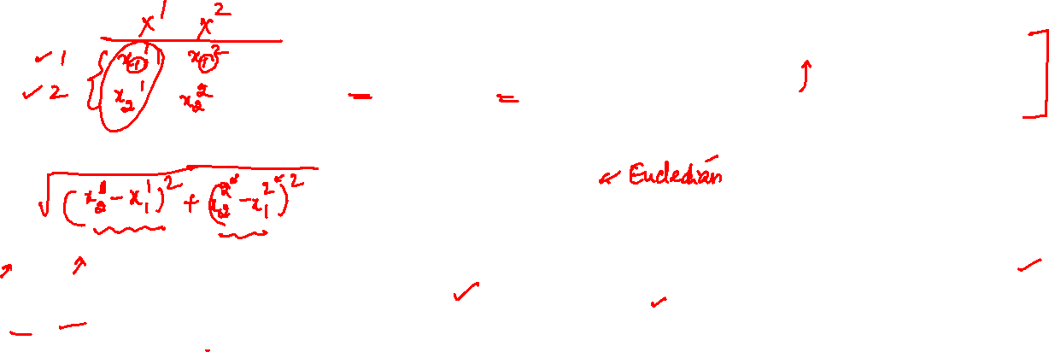

Vectors and distances
Consider another example with two points $X^{1}$ and $X^{2}$
$$X^{1}=\left[\begin{aligned}{x_{1}}^{1} \\ {x_{2}}^{1}\end{aligned}\right]X^{2}=\left[\begin{aligned}{x_{1}}^{2} \\ {x_{2}}^{2}\end{aligned}\right]$$
The distance between these two can be calculated
$l=\left|X^{2}−X^{1}\right|$₂
$$l=\sqrt{{({x_{1}}_{}^{2}−{x_{1}}^{1})}^{2}+{({x_{2}}_{}^{2}−{x_{2}}^{1})}^{2}}$$
$$l=\sqrt{{\left(X_{2}−X_{1}\right)}^{T}(X_{2}−X_{1})}$$

Slide 33
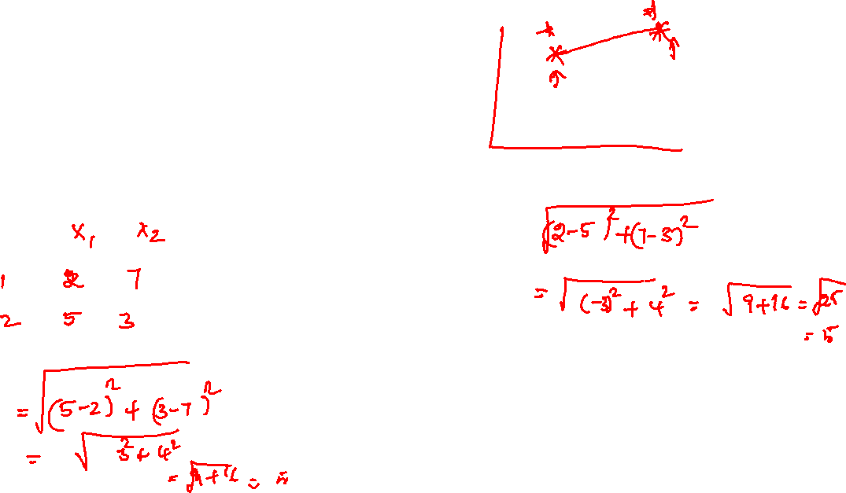
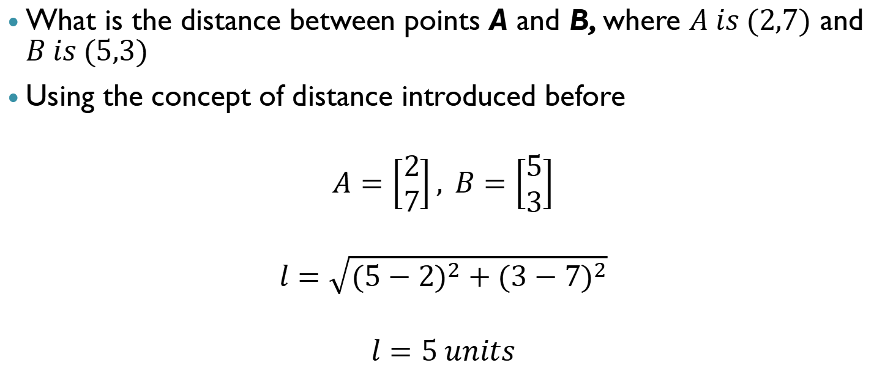
Vectors and distances: Example
What is the distance between points A and B, where $A is (2,7)$ and $B is (5,3)$
Using the concept of distance introduced before
$$A=\left[\begin{aligned}2 \\ 7\end{aligned}\right], B=\left[\begin{aligned}5 \\ 3\end{aligned}\right]$$
$$l=\sqrt{{(5−2)}^{2}+{(3−7)}^{2}}$$
$$l=5 units$$

Slide 34
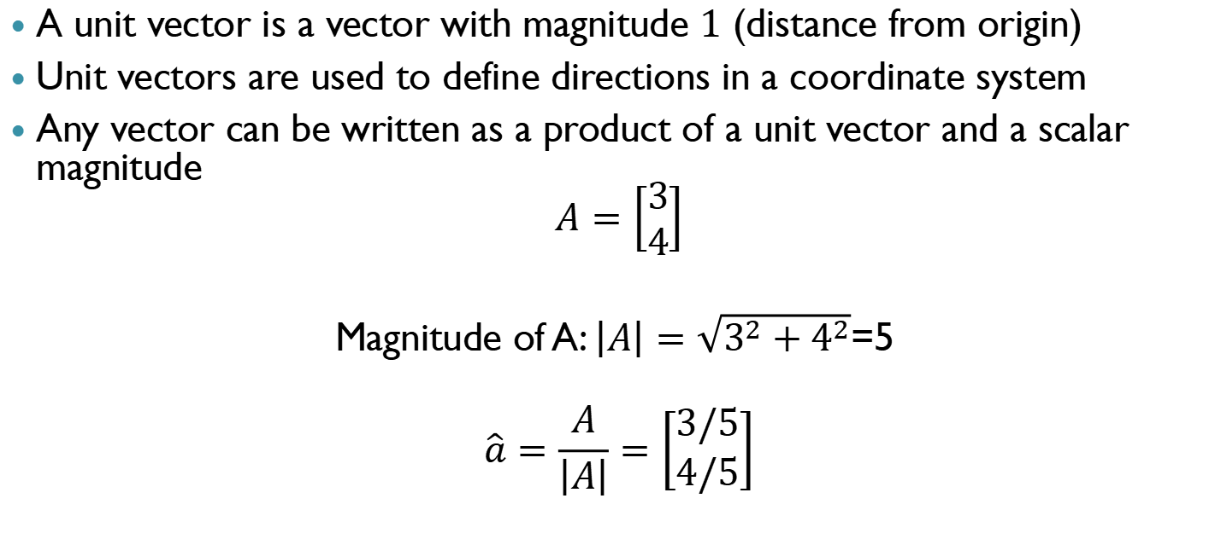
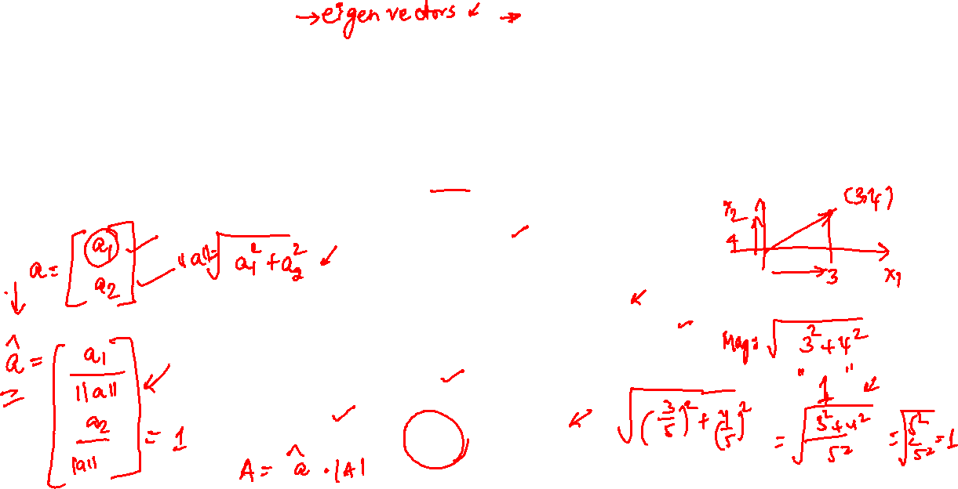
Unit vector
A unit vector is a vector with magnitude $1$ (distance from origin)
Unit vectors are used to define directions in a coordinate system
Any vector can be written as a product of a unit vector and a scalar magnitude
$$A=\left[\begin{aligned}3 \\ 4\end{aligned}\right]$$
Magnitude of A: $\left|A\right|=\sqrt{3^{2}+4^{2}}$=5
$$\hat{a}=\frac{A}{\left|A\right|}=\left[\begin{aligned}3/5 \\ 4/5\end{aligned}\right]$$

Slide 35
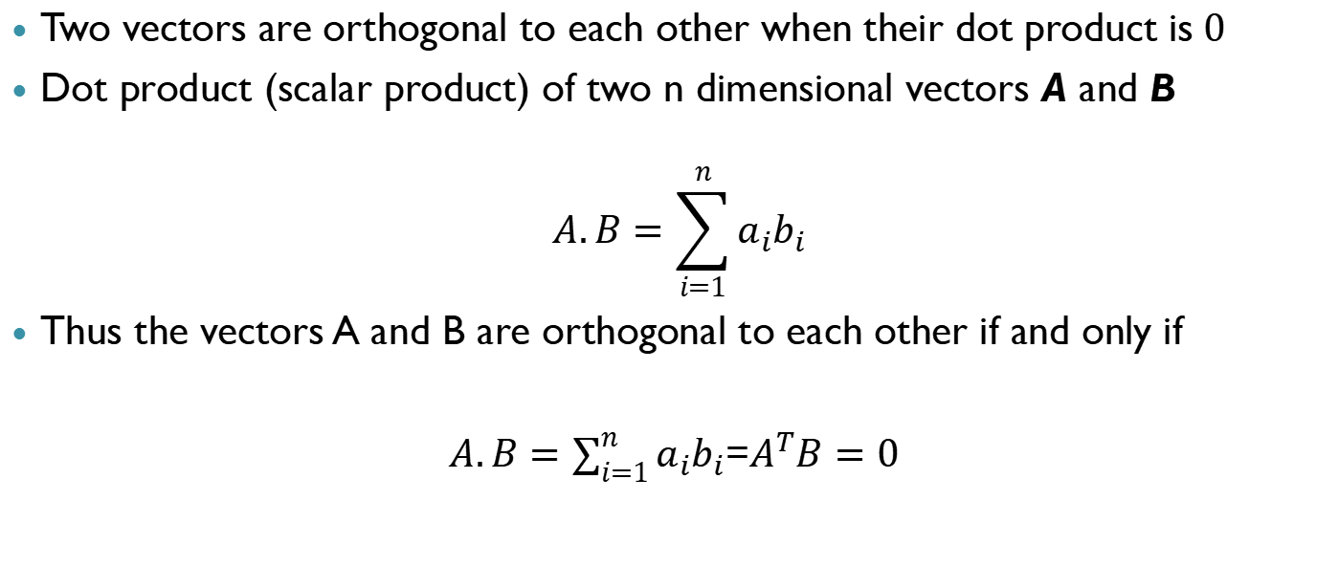

Orthogonal vectors
Two vectors are orthogonal to each other when their dot product is$0$
Dot product (scalar product) of two n dimensional vectors A and B
$$A.B=\sum_{i=1}^{n}{a_{i}b_{i}}$$
Thus the vectors A and B are orthogonal to each other if and only if
$A.B=\sum_{i=1}^{n}{a_{i}b_{i}}$=$A^{T}B=0$

Slide 36


Orthogonal vectors: Example
Consider the vectors $v_{1}$ and $v_{2}$ in 3D space. Identify if they are orthogonal to each other
$$v_{1}=\left[\begin{aligned}1 \\ −2 \\ 4\end{aligned}\right]$$
$$v_{2}=\left[\begin{aligned}2 \\ 5 \\ 2\end{aligned}\right]$$
Taking the dot product of the vectors
$v_{1}.v_{2}={V_{1}}^{T}V_{2}^{}=[1−2 4]\left[\begin{aligned}2 \\ 5 \\ 2\end{aligned}\right]$ = 0
Hence, the vectors are orthogonal

Slide 37


Orthonormal vectors
Orthonormal vectors are orthogonal vectors with unit magnitude
Example
$$v_{1}=\left[\begin{aligned}1 \\ −2 \\ 4\end{aligned}\right]/\sqrt{1^{2}+{(−2)}^{2}+4^{2}}$$
$v_{2}=$ $\left[\begin{aligned}2 \\ 5 \\ 2\end{aligned}\right]$/$\sqrt{2^{2}+5^{2}+2^{2}}$
Note that we have taken the vectors from the previous example and converted them into unit vectors by dividing them with their magnitudes
All orthonormal vectors are orthogonal

Slide 38


Eigenvalues and eigenvectors
We have previously seen linear equations of the form $Ax=b$
What is the geometrical interpretation of this equation?
We can make an interpretation as follows
When vector $x$ is operated on by $A$, we obtain a new vector $b$ with a different orientation

Slide 39


Eigenvalues and eigenvectors
Operator representation
The newly obtained $b$ vector represents a new orientation. So we ask the following question
Are there directions for a matrix $A$ such that when the matrix operates on these directions they maintain their orientation same for multiplication by a scalar (positive or negative)?
That is
x
A
Ax = b
x
A
Ax = b = λx

Slide 40



Eigenvalues and eigenvectors
The mathematical formulation of our question is
$$Ax=λx$$
The constant $λ (positive)$ represents the amount of stretch or shrinkage the attributes $x$ go through in the $x$ direction
The solutions ($x$) are known as eigenvectors and their corresponding $λ$ are eigenvalues
y
x
x
λx

Slide 41


Eigenvalues and eigenvectors
We can find the eigenvalues as follows
$$Ax=λx A\left(n×n\right);x(n×1)$$
$$Ax−λIx=0$$
$$\left(A−λI\right)x=0$$
Thus the eigenvalues of the equation can be identified using
$$|A−λI|=0$$
Substituting the eigenvalues in the original equation will help us find solutions for the eigenvector $x$

Slide 42


Eigenvalues and eigenvectors: Examples
Consider the following example with the given A matrix
$$A=\left[\begin{matrix}8 & 7 \\ 2 & 3\end{matrix}\right]$$
$$\left[\begin{matrix}8 & 7 \\ 2 & 3\end{matrix}\right]\left[\begin{aligned}x_{1} \\ x_{2}\end{aligned}\right]=λ\left[\begin{aligned}x_{1} \\ x_{2}\end{aligned}\right]=\left[\begin{aligned}{λx}_{1} \\ {λx}_{2}\end{aligned}\right]$$
$$\left|A−λI\right|=\left|\left[\begin{matrix}8 & 7 \\ 2 & 3\end{matrix}\right]−λ\left[\begin{matrix}1 & 0 \\ 0 & 1\end{matrix}\right]\right|=\left|\left[\begin{matrix}8−λ & 7 \\ 2 & 3−λ\end{matrix}\right]\right|=0$$
$$\left(8−λ\right)\left(3−λ\right)−14=0$$
$$λ^{2}−11λ+10=0$$
$$λ=(10,1)$$
Thus we identify two eigenvalues and now we proceed to find the corresponding eigenvectors

Slide 43


Eigenvalues and eigenvectors: Examples
$$\left[\begin{matrix}8 & 7 \\ 2 & 3\end{matrix}\right]\left[\begin{aligned}x_{1} \\ x_{2}\end{aligned}\right]=λ\left[\begin{aligned}x_{1} \\ x_{2}\end{aligned}\right]$$
$λ=1$
$$\left[\begin{matrix}8 & 7 \\ 2 & 3\end{matrix}\right]\left[\begin{aligned}x_{1} \\ x_{2}\end{aligned}\right]=\left[\begin{aligned}x_{1} \\ x_{2}\end{aligned}\right]$$
$$\left[\begin{aligned}{8x}_{1}+7x_{2} \\ 2x_{1}+3x_{2}\end{aligned}\right]=\left[\begin{aligned}x_{1} \\ x_{2}\end{aligned}\right]$$
$$x_{1}+x_{2}=0$$
Thus the eigenvector (unit) corresponding to $λ=1$is
$$X=\left[\begin{aligned}\frac{1}{\sqrt{2}} \\ \frac{−1}{\sqrt{2}}\end{aligned}\right]$$

Slide 44


Eigenvalues and eigenvectors: Examples
$λ=10$
$$\left[\begin{matrix}8 & 7 \\ 2 & 3\end{matrix}\right]\left[\begin{aligned}x_{1} \\ x_{2}\end{aligned}\right]=\left[\begin{aligned}{10x}_{1} \\ {10x}_{2}\end{aligned}\right]$$
$$\left[\begin{aligned}{8x}_{1}+7x_{2} \\ 2x_{1}+3x_{2}\end{aligned}\right]=\left[\begin{aligned}10x_{1} \\ {10x}_{2}\end{aligned}\right]$$
$$7x_{2}=2x_{1}$$
Thus the eigenvector (unit) corresponding to $λ=10$
$$X=\left[\begin{aligned}\frac{7}{\sqrt{53}} \\ \frac{2}{\sqrt{53}}\end{aligned}\right]$$

Slide 45


Connections between eigenvectors and nullity
Symmetric matrices have a very important role in data sciences
In fact, symmetric matrices of the form $A^{T}A$ or $AA^{T}$are often encountered
Eigenvalues of matrices of the form $A^{T}A$ or $AA^{T}$ while being real and non-negative
As discussed for general symmetric matrices, there will be $n$ linearly independent eigenvectors
What is the connection between the eigenvectors and the column space and null space of a (symmetric) matrix ?

Slide 46

Connections between eigenvectors and null space
What happens when the eigenvalues become zero?
The eigenvectors corresponding to zero eigenvalues are in the null space of the matrix
Conversely, if the eigenvalue corresponding to an eigenvector is not zero then that eigenvector cannot be in the null space of a matrix

Slide 47

Singular Value Decomposition

Slide 48


Singular Value Decomposition
SVD – factorization of 1 matrix (any matrix) into 3 matrices
Any m×n matrix A can be factored into
The columns of U (m×m) are eigenvectors of AA^{T}
The columns of V (n×n) are eigenvectors of A^{T}A
The diagonal matrix Σ has square roots of eigenvalues from A^{T}A and not from A
Those positive entries will be σ₁,…, σ_{r}. They are the singular values of A and they fill the first $r$ places in the main diagonal of Σ – when A has rank $r$. The rest of Σ is zero
A= UΣV^{T} = (orthogonal) (diagonal) (orthogonal)

Slide 49


Singular Value Decomposition
Example:
For a matrix A = To factorize A as A = UΣV^{T}
To find U:
AA^{T} = ; eigenvalues = 4, 2
Eigen vectors of AA^{T} = for the eigenvalue 4 and for the eigenvalue 2
To make the vectors orthonormal, divide them by its length, which will
give and ; U =

Slide 50

Singular Value Decomposition
To find V:
A^{T}A = ; eigenvalues = 4, 2, 0
Eigenvectors of A^{T}A = for the eigenvalue 4 , for the eigenvalue 2
and for the eigenvalue 0
To make the vectors orthonormal, divide them by its length, which will
give , and ; V =

Slide 51

Singular Value Decomposition
The diagonal matrix Σ takes the square root of the nonzero eigenvalues
Σ =
So, we have,
A =
U
Σ
V^{T}

Slide 52

Singular Value Decomposition
Example:
For a matrix A = To factorize A as A = UΣV^{T}
To find U:
AA^{T} = ; eigenvalues = 3, 1, 0
Eigenvectors of AA^{T} = for the eigenvalue 3 , for the eigenvalue 1
and for the eigenvalue 0

Slide 53

Singular Value Decomposition
To make the vectors orthonormal, divide them by its length, which will
give , and
⇒ U =

Slide 54

Singular Value Decomposition
To find V:
A^{T}A = ; eigenvalues = 3, 1
Eigenvectors of A^{T}A = for the eigenvalue 3 and for the eigenvalue 1
To make the vectors orthonormal, divide them by its length, which will
give and ; V =

Slide 55

Singular Value Decomposition
The diagonal matrix Σ takes the square root of the nonzero eigenvalues
Σ =
So, we have,
A =
U
Σ
V^{T}

Slide 56

Singular Value Decomposition (SVD)
SVD (economical) of the data matrix
U and V are orthonormal matrices
S is a diagonal matrix whose diagonal entries (ordered from largest to smallest) are called singular values
Columns of U are left singular vector and columns of V are the right singular vectors of the data matrix
$$svd(X_{s})=U_{N×p}S_{p×p}V_{p×p}^{T}$$

Slide 57


SVD and Eigenvectors
SVD of data matrix are related to eigenvectors of covariance matrix
Columns of V are eigenvectors of $X_{s}X_{s}^{T}$(variable direction)
Columns of U are eigenvectors of (sample direction)
Singular values are square root of eigen values
$$X_{s}^{T}X_{s}$$

Slide 58
Demonstration of image compression using SVD
Example: Image compression: Image Compression Using SVD (redwoods.edu)
Section 21 SVD and Image Compression | MATH 236: Linear Algebra (tom-halverson.github.io)
https://nbviewer.jupyter.org/gist/frankcleary/4d2bd178708503b556b0 (Python code)

